Slide 1
FM TRANSMITTER
PRESENTED BY :
ABHIJEET TAKLE (PC-46)
&
JAY SRIVASTAVA (PC 53)

Slide 2
CONTENTS
INTRODUCTION
WORKING PRINCIPLE
COMPONENTS USED
CIRCUIT DIAGRAM
APPLICATIONS OF FM TRANSMITTER
ADVANTAGES
DISADVANTAGES

Slide 3
INTRODUCTION
FM transmission is done by the process of audio pre amplification, modulation and then transmission.
Here we have adapted the same formula by first amplifying the audio signal, generating a carrier signal using an oscillating and then modulating the carrier signal with the amplified audio signal.
The amplification is done by an amplifier, whereas the modulation and carrier signal generation is done by an variable frequency.
The frequency is set at anywhere between the FM frequency range is from 88MHz to 108MHz

Slide 4
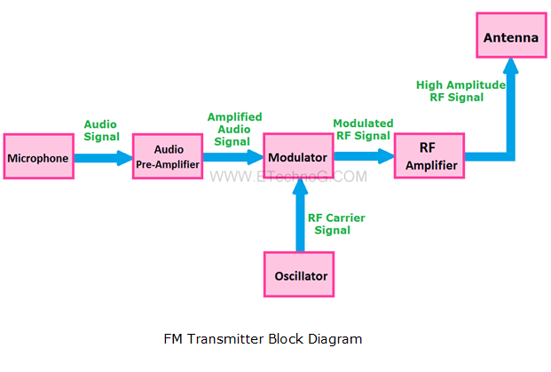
WORKING PRINCIPLE
FM transmission is done by the process of audio pre amplification, modulation and then transmission. ... The power of the FM signal from the oscillator is then amplified using a power amplifier to produce a low impedance output, matching that with the antenna

Slide 5
COMPONENTS USED
Design of Audio Pre-amplifier:
Here we are designing a simple single stage common emitter amplifier as the pre-amplifier.
Selection of V(cc) : Here we have selected the NPN Bipolar Junction Transistor, BC109. Since V_{CEO} for this transistor is around 40V, we choose a much lesser Vcc, of about 9V.
Selection of Load Resistor, R4: R4=4.5K. We select a 5K resistor for better operation.
Selection of Voltage Divider Resistors R2 and R3: The voltage divider resistors, R2=22K resistor,R3=90K resistor.
Selection of Emitter Resistor R5: R5=540 Ohms. Here we select a 500 Ohms resistor. It serves the purpose of bypassing the emitter current.
Selection of coupling capacitor, C1: Here we select a value of 5 uF.
Selection of Microphone Resistor R1: Here we select a 18K resistor.
Selection of Bypass Capacitor, C4: Here we select an electrolyte capacitor of 15 uF, which bypasses the DC signal.

Slide 6
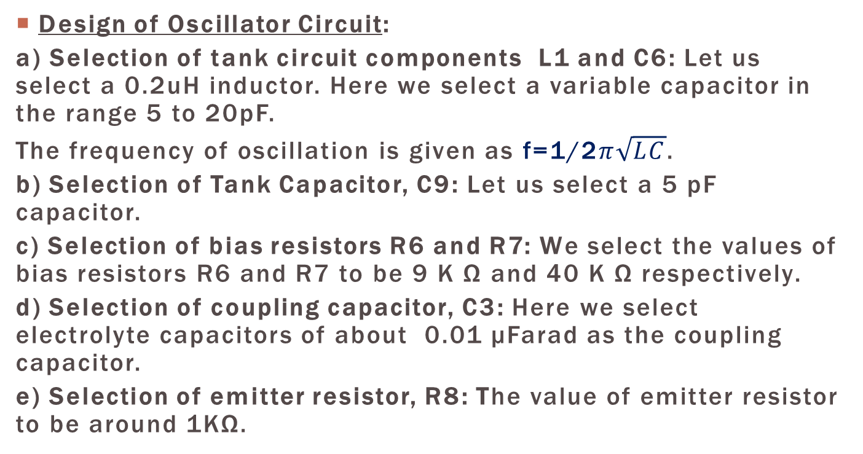
.
Design of Oscillator Circuit:
a) Selection of tank circuit components L1 and C6: Let us select a 0.2uH inductor. Here we select a variable capacitor in the range 5 to 20pF.
The frequency of oscillation is given as f=1/2$π\sqrt{LC}$.
b) Selection of Tank Capacitor, C9: Let us select a 5 pF capacitor.
c) Selection of bias resistors R6 and R7: We select the values of bias resistors R6 and R7 to be 9 K Ω and 40 K Ω respectively.
d) Selection of coupling capacitor, C3: Here we select electrolyte capacitors of about 0.01 μFarad as the coupling capacitor.
e) Selection of emitter resistor, R8: The value of emitter resistor to be around 1KΩ.

Slide 7
.
Design of Power Amplifier Circuit:
Since we require a low power output, we prefer using a class A power amplifier with LC tank circuit at the output. Here we select the biasing resistor to be about 20kΩ and coupling capacitor of about 10 pF.
Selection of Antenna:
Since the range is about 2 km, we can prepare an antenna using a stick antenna or a wire of 30 inches approximately which would be about 1/4th of the transmitting wavelength.

Slide 8
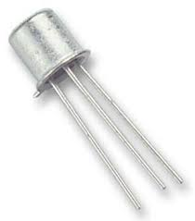
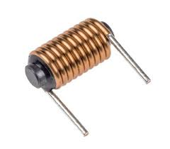
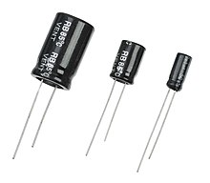
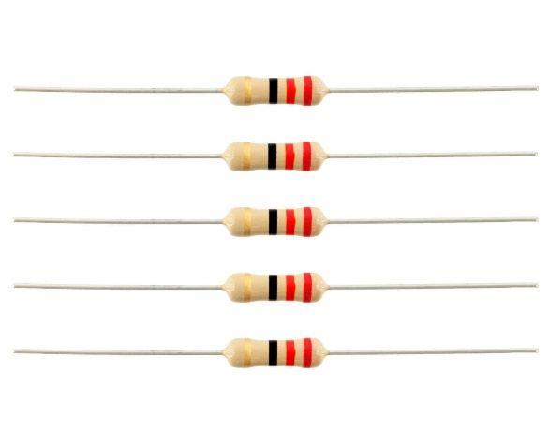
.
BC109BP TRANSISTOR
INDUCTORS
CAPACITORS
RESISTORS

Slide 9
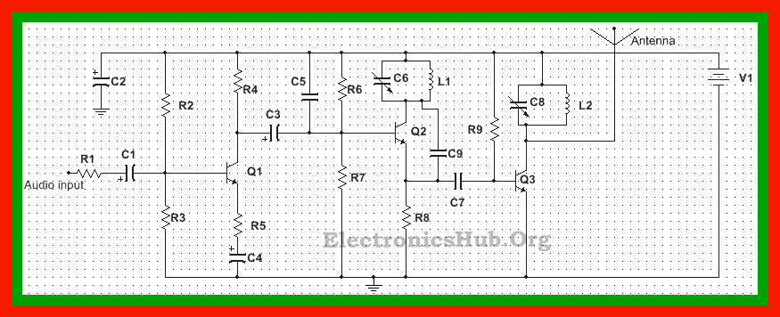
CIRCUIT DIAGRAM

Slide 10
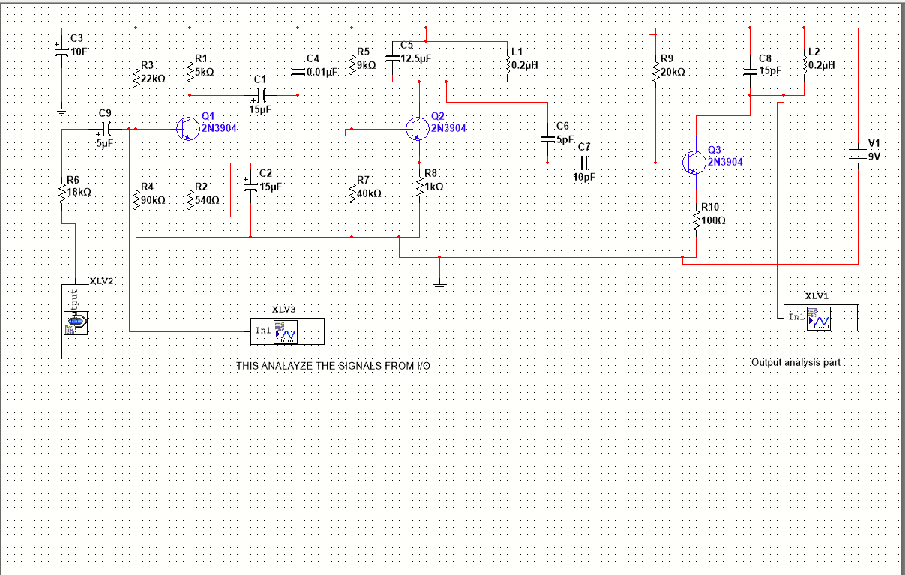
Implemented diagram

Slide 11
WORKING
Audio input from the microphone or any other device is first amplified using the common emitter configuration of BC109.
Audio signal from the microphone is very low level signal, of the order of mill volts. This extremely small voltage needs to be first amplified. A common emitter configuration of a bipolar transistor, biased to operate in class A region, produces an amplified signal.
This amplified signal is then given to the oscillator circuit through the coupling capacitor.
Another important aspect of this circuit is the Colpitts oscillator circuit. This is a LC oscillator where energy moves back and forth between the inductor and capacitor forming oscillations. It is mainly used for RF application.

Slide 12
.
When this oscillator is given a voltage input, the output signal is a mixture of the input signal and the oscillating output signal, producing a modulated signal. In other words, the frequency of the oscillator generated circuit varies with the application of an input signal, producing a frequency modulated signal.
The output signal from the emitter of the transistor is coupled to the input of the power amplifier transistor using the coupling capacitor. As this signal is amplified, the variable capacitor in the power amplifier section tends to maintain an output matching with that of the oscillator. The amplified RF signal is then transmitted using antenna.

Slide 13
APPLICATIONS
Broadcasting : Frequency modulation can be used for the broadcasting of FM radio. This helps in larger signal to noise ratio.
Telemetry, radar and seismic prospecting, EEG monitoring of newborns etc also use the technique of frequency modulation.
It is also used in music synthesis, some systems that use video-transmission and also for magnetic tape-recording systems.
These are used in wireless components for vehicles and offices.

Slide 14
ADVANTAGES OF FM TRANSMITTER
Frequency modulation is resilient to signal level variations. Any variation in signal level does not affect the output as long as the receiver is able to cope up with the signal level. This makes the FM ideal for two-way radio communication or mobile communication application.
Frequency modulation is also resilient to noise and interference.
It is also easier to apply modulation at a low level power stage of a transmitter.
With the help of frequency modulated signals, we can use RF amplifiers.

Slide 15
DISADVANTAGES OF FM TRANSMITTER
FM doesn’t have as efficient spectral efficiency as some of the other modulation formats.
Frequency modulation has a little more complicated and slightly more expensive demodulator than the AM.
The sidebands for frequency modulation transmission extend out to infinity. While they are significant for wideband FM transmissions, they fall small for narrow band FM. Filters are used.

Slide 16
CONCLUSION
Hence , the frequency of the oscillated wave we got is 91MHz which is in the range of FM Bandwidth i.e from 88MHz to 108 MHz.
The VCEO of the transistor used in the above circuit is 40V , thus a power supply of lower voltages is used (a 9V Power supply)
The height of the antenna used to be 1/4th of wavelength of the signal used.

Slide 17
THANK YOU

